Slide 1
Problem Manage a Server Outage Scenario & an Issue & Change Request Management System
Module Project
Module: NICF Capstone Project using Java
Course: NICF Advanced Certificate in Software & Applications (Development & Deployment)
Start Date : 27 July 2023
End Date : 18 August 2023
Submission Date : 18 August 2023
Learner Name : Agung Yuda Pratama
Enrollment ID : BDSE-0922-076
Presentation Date : 23 August 2023

Slide 2
Contents
Document History
Version Number | Effective Date of release | Summary of Included Changes | Author
1 | 4th March 2016 | First Edition | Satya CVS
2 | 23rd Jul 2018 | Changed for Module 6 | Shrinivas K R

Slide 3
Contents
Contents
S. No. | Description
01 | Principles of Problem Management
02 | Problem Management Example
03 | Tools, Process & Technologies
04 | Investigation & Diagnosis
05 | Explain Prioritization
06 | Problem Management Solution
07 | Systems you will Implement
08 | Project Milestones & Tasks
09 | Milestone Feedback & Action taken
10 | Modifications Made based On Feedback
11 | Project Results
12 | Proposed Improvements

Slide 4


Slide 5
1. Principles of Problem Management
Problem Identification
Sources of Identification: Problem identification can come from user reporting, system monitoring, and analysis of operational data.
Initial Categorization: The identified problems are given an initial category based on their type or impact, assisting in shifting treatment priorities.
Problem Investigation
High-priority or high-risk problems should be resolved first, as their impact on the service is highest.
Investigation Priority: Issues with high impact or risk receive higher priority in the investigation process.
Data Analysis: Incident data and other information is analyzed to identify patterns or trends that can assist in investigations.
Source Identification: The main aim of an investigation is to identify the underlying source of the problem.

Slide 6
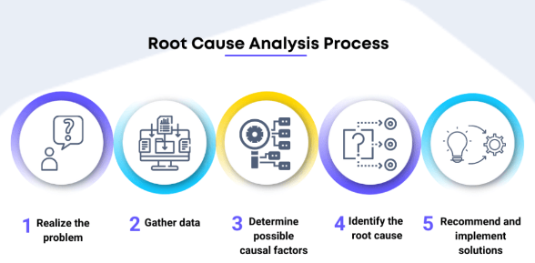
1. Principles of Problem Management
Problem Analysis
RCA
(Root Cause Analysis)
Problem Resolution
Solution Development:
Change Deployment:
Review
Effectiveness Evaluation
Lessons Learned

Slide 7
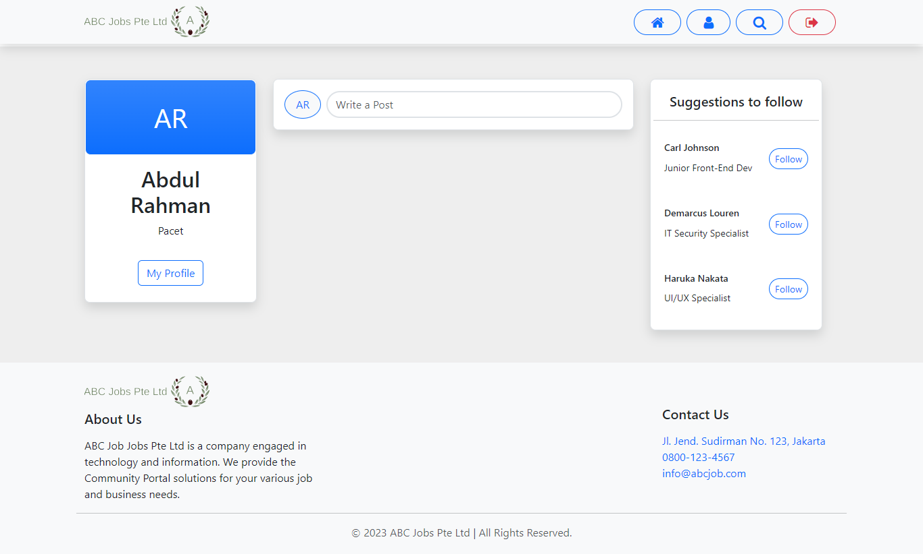
2. Problem Management Example
Problem Identification:
User Thread Not Showing
Screenshot of client-side screen

Slide 8
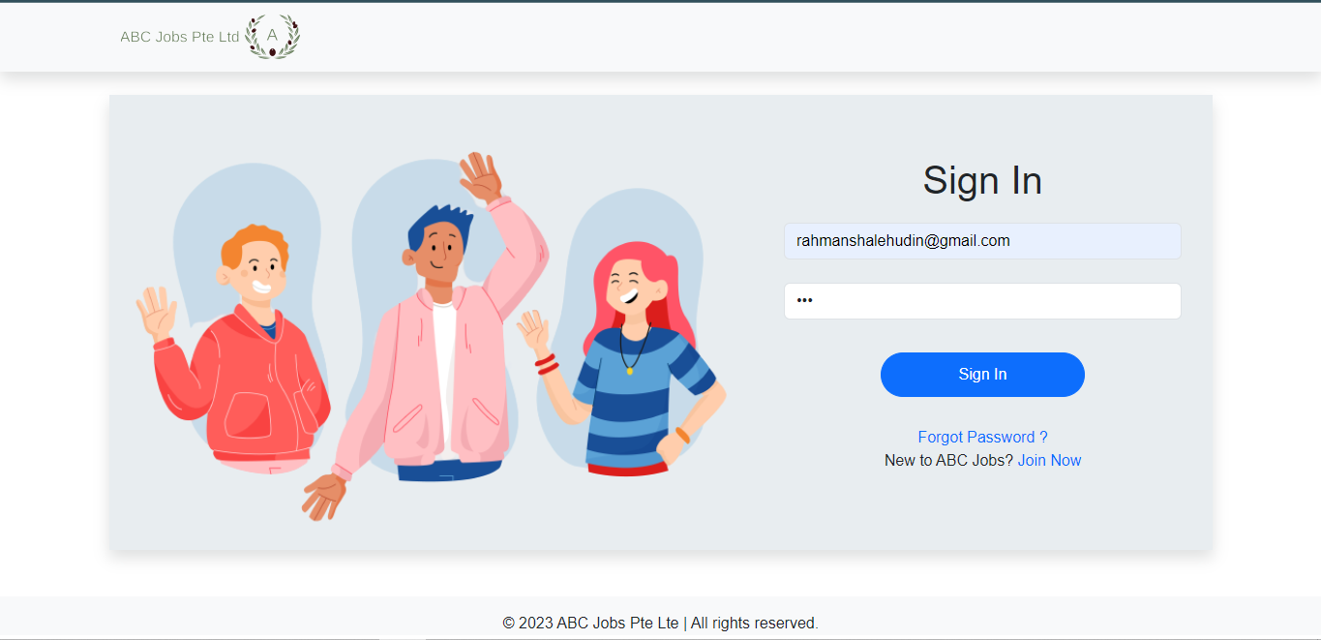
2. Problem Management Example
Problem Identification:
Error Viewing Invalid Credentials
Screenshot of client-side screen

Slide 9
3. Tools, Process & Technologies
Issue Identification and Tracking Document
Created By: |  |  | Agung Yuda |  | Last Update By: Agung Yuda
Date Created: |  |  | 05-08-2023 |  | Last Revision Date: 18-08-2023
Issue No. | Issue Description | Issue Type | Identified By | Date Identified | Issue Assigned To | Target Resolution Date | Priority | Status | Date Resolved | Resolution Description
1 | User Thread Not Showing in the Dashboard | Technical Issues | Customer | 14-8-2023 | Software Development Team | 15-8-2023 | High | Resolved | 15-8-2023 | Correcting Items and Var in JSP Page
2 | Invalid login details error not displayed | Technical Issue | Software Tester Team | 07-8-2023 | Software Development Team | 08-8-2023 | High | Resolved | 08-8-2023 | Adding the code of message

Slide 10
3. Tools, Process & Technologies
Problem Investigation
Techniques = Root Cause Analysis
Tool = Brainstorming
Process:
Utilize Brainstorming to analyze the root causes of identified issues systematically.
Identify major categories that could contribute to the issue, such as people, processes, equipment, environment, and materials.
Drill down each category to identify potential root causes that might lead to the observed problem.
Encourage cross-functional discussions to gather insights from various team members.
Prioritize root causes based on their significance and relevance to the issue, enabling targeted corrective actions—problem Resolution.

Slide 11
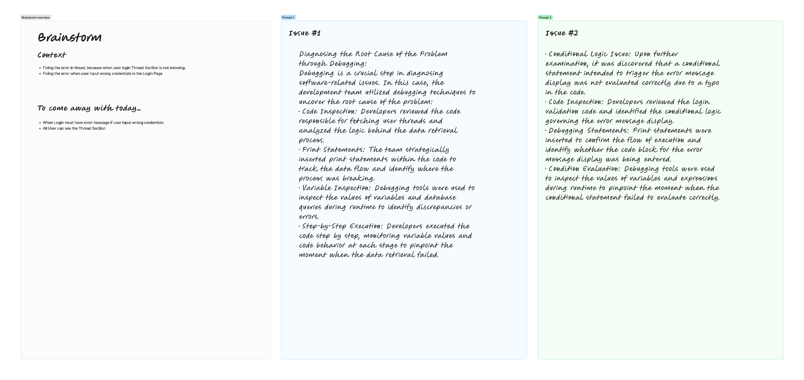
4. Investigation & Diagnosis
Investigate the problem
List out the possible causes of the problem and analyses them

Slide 12
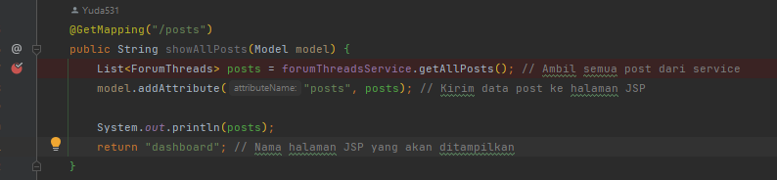
4. Investigation & Diagnosis
Diagnosing the Root Cause of the Problem through Debugging:
Debugging is a crucial step in diagnosing software-related issues. In this case, the development team utilized debugging techniques to uncover the root cause of the problem:
Code Inspection: Developers reviewed the code responsible for fetching user threads and analyzed the logic behind the data retrieval process.
Print Statements: The team strategically inserted print statements within the code to track the data flow and identify where the process was breaking.
Variable Inspection: Debugging tools were used to inspect the values of variables and database queries during runtime to identify discrepancies or errors.
Step-by-Step Execution: Developers executed the code step by step, monitoring variable values and code behavior at each stage to pinpoint the moment when the data retrieval failed.

Slide 13
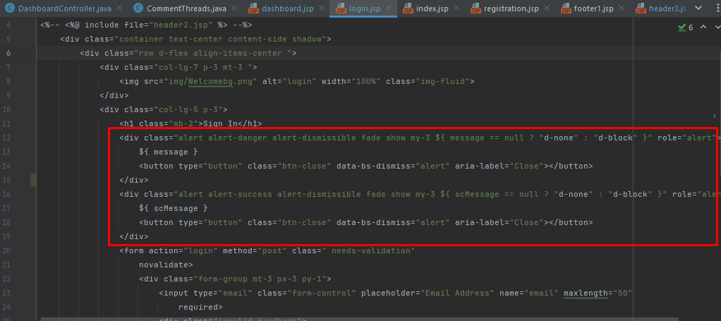
4. Investigation & Diagnosis
Debugging was essential in uncovering the root cause of this issue:
Code Inspection: Developers reviewed the login validation code and identified the conditional logic governing the error message display.
Debugging Statements: Print statements were inserted to confirm the flow of execution and identify whether the code block for the error message display was being entered.
Condition Evaluation: Debugging tools were used to inspect the values of variables and expressions during runtime to pinpoint the moment when the conditional statement failed to evaluate correctly.
By leveraging debugging techniques, the development team identified the root cause—conditional statement error—and rectified the issue. The error message for invalid login details was reinstated, providing users with the necessary feedback.

Slide 14
4. Investigation & Diagnosis
Known Error Database
Ticket no. | Issue Description | Issue Type | Root Cause | Workaround | Status | Date Resolve
1. | User Thread Not Showing in the Dashboard | Technical Issues | There is mistake items and var in JSP Page | Correcting Items and Var in JSP Page | Resolved | 15-8-2023
2 | Invalid login details error not displayed | Technical Issue | Code for Error message is empty | Adding the code of message | Resolved | 08-8-2023

Slide 15
5. Explain Prioritization
Priorities and categories problems:
Tier 1: Low priority issues
The first tier is for basic or minor problems.
Handle low-priority incidents that do not impact the business. It is easy to solve and repeats a lot. Usually, incidents here are converted into incident models.
Tier 2: medium priority issues
The second tier is the major problems.
Dealing with incidents that impact users but not the business as a whole. These incidents require more skill or access to resolve.
Tier 3: High Priority Issues
The third tier is the critical problem
Manage incidents that affect the entire organization and multiple users. These incidents are high priority and often enter the Major Incident Response process.

Slide 16
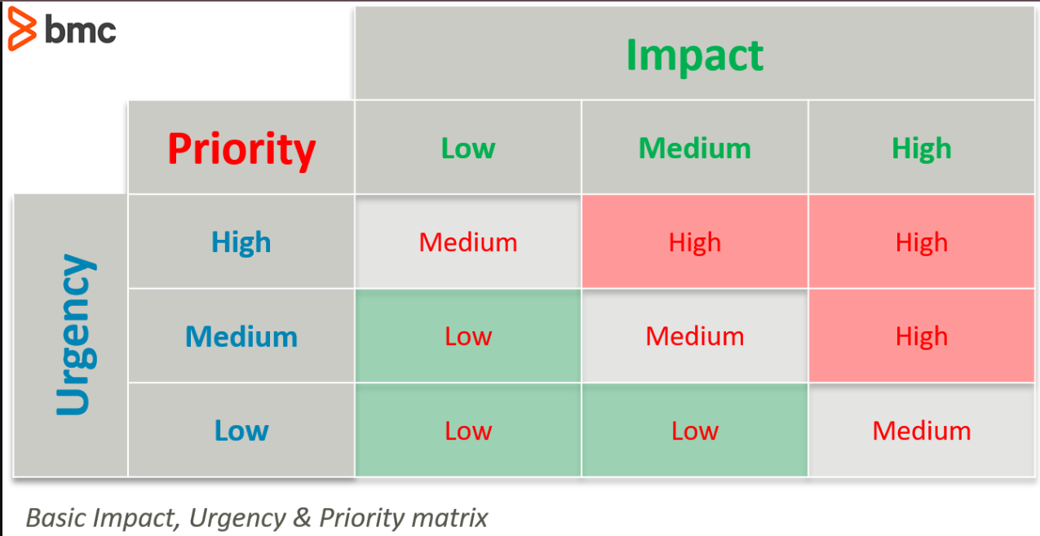

Slide 17
5. Explain Prioritization
Issues:
1. When user login, and they input incorrect credentials. Error Message not Appear
Tier 2- major problems
Issues:
1. After user login, Thread Section is not showing On Dashboard
Tier 1- minor problem
Problems Categories Diagram:

Slide 18
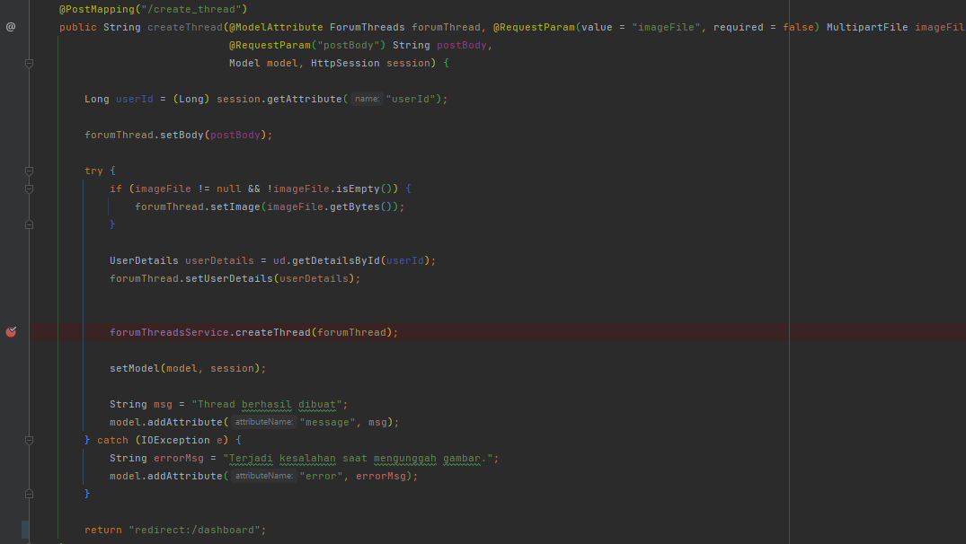
6. Problem Management Solution
Solution for Thread not showing in The Dashboard:
Debug create_thread endpoint
Check the logic in create_thread endpoint
Ensure in the JSP have a correct var and items it will sync with backend and database.
Asd Ensure have implement endpoint to call all thread
Debug is success and not have a problem with endpoint

Slide 19
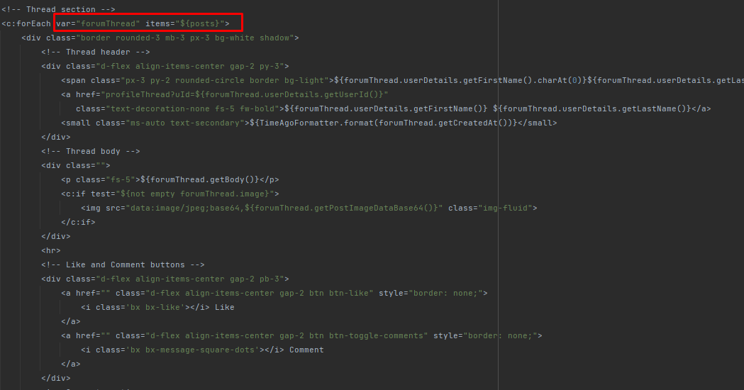
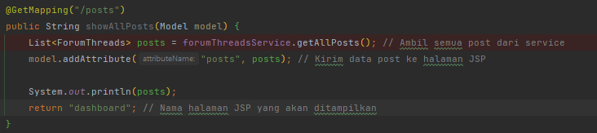
6. Problem Management Solution
Identify the var and items. And check the attribute in the thread
And this is the endpoint for call the thread

Slide 20
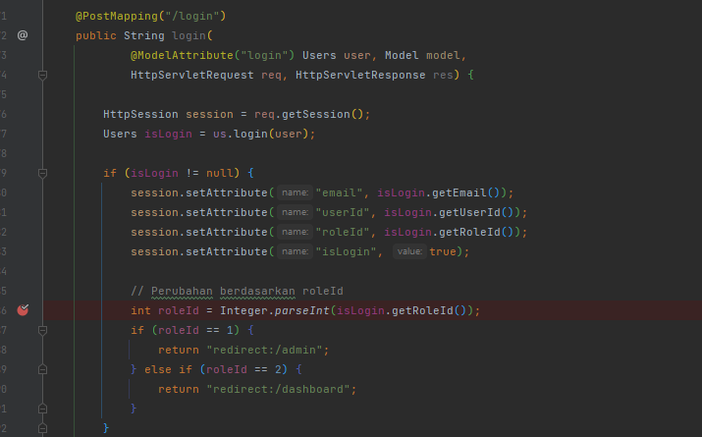
6. Problem Management Solution
Solution for Invalid login details error not displayed:
Debug Login Endpoint
Ensure the data user has saved in database
Identify the login.jsp have a correct variable to synchronize with backend
Ensure the login.jsp have a code for show the message

Slide 21
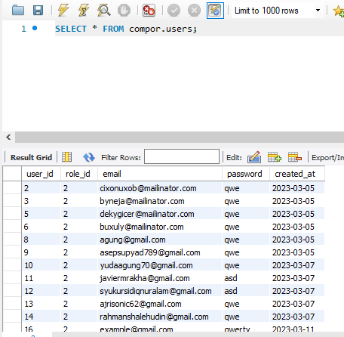
6. Problem Management Solution
The Data of User already registered has saved to database

Slide 22
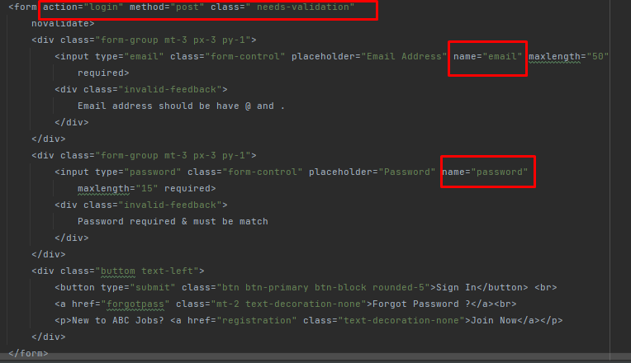
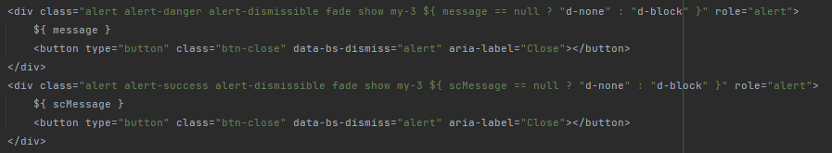
6. Problem Management Solution
Ensure All the variables is correct
Add the message code if error login

Slide 23

7. Systems you will Implement
The brainstorming method will be implemented to facilitate effective problem-solving and idea generation. Brainstorming is a collaborative and creative approach that encourages team members to contribute ideas, suggestions, and potential solutions to identified issues. By leveraging the team's collective expertise and diverse perspectives, the brainstorming method can lead to innovative and viable solutions.
Brainstorming Method:

Slide 24
8. Project Milestones & Tasks
Project Task ID | Project Task Description | Project Milestone ID
1 | Identify problems and develop issue tracking documents | 1
2 | Problem investigation and diagnosis | 1
3 | Problem prioritization | 1
4 | Problem resolution | 2
5 | Creating a known error database | 3

Slide 25
9. Milestone Feedback & Action taken
Project Milestone ID | Milestone Feedback received from Tutor / Learning Facilitator | Action Taken (Yes / No)

Slide 26
10. Proposed Improvements
List of Improvements
Try to use Another Method for Problem Management
Try to use Another tool like Draw.Io to breakdown the problem

